Slide 1
Distributed Systems Design COMP 6231
Processes
Lecture 3
Essam Mansour

Slide 2
Today…
Last Session:
Architectures for distributed systems
Today’s Session:
Processes
Threads
Virtualization

Slide 3
Communicating Entities in Distributed Systems
Communicating entities in distributed systems can be classified into two types:
System-oriented entities
Processes
Threads
Nodes
Problem-oriented entities
Objects (in object-oriented programming based approaches)

Slide 4

Classification of Communication Paradigms
Communication paradigms can be categorized into three types based on where the entities reside. If entities are running on:
1. Same Address-Space
Global variables, Procedure calls, …
2. Same Computer but Different Address-Spaces
Files, Signals, Shared Memory…
3. Networked Computers
Socket Communication
Remote Invocation

Slide 5
Processes vs Threads
A program to be executed needs more than just binary code.
It needs:
Memory, and
operating system resources
a register may hold an instruction, or storage address,
program counter keeps track of where a computer is in its program sequence,
“stack” is a data structure that stores information about the active subroutines of a computer program

Slide 6
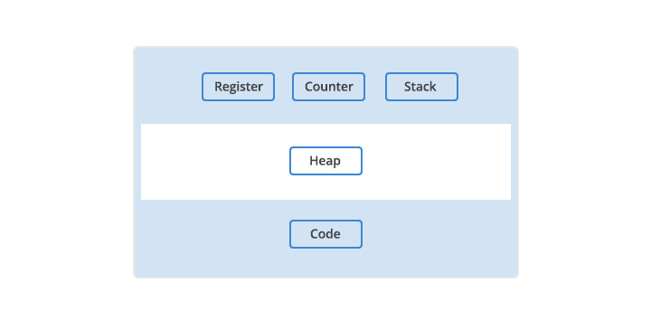

Processes vs Threads
A computer process
May we have
Multiple processes
Of the same program?

Slide 7
Processes vs Threads
A computer process
Yes, but each process has a separate memory address space, i.e., a process runs independently and is isolated from other processes.

Slide 8
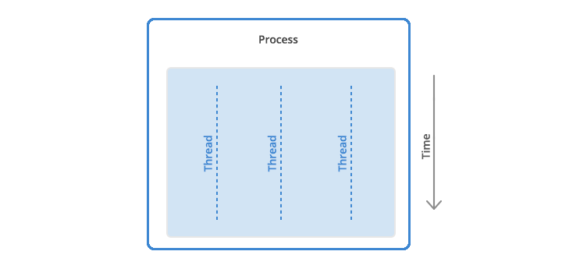
Processes vs Threads
A thread could be defined as the unit of execution within a process.

Slide 9
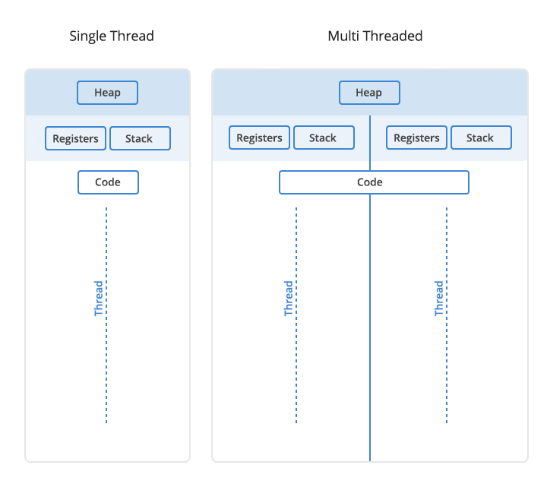
Processes vs Threads
A thread could be defined as the unit of execution within a process.
What multithreaded
process does share?

Slide 10
Processes vs Threads
A thread could be defined as the unit of execution within a process.
Threads could be seen as
lightweight processes as
they have their own stack but
can access shared data.
Is it easier to
enable communication
between threads or
Processes?
What multithreaded
process does share?

Slide 11
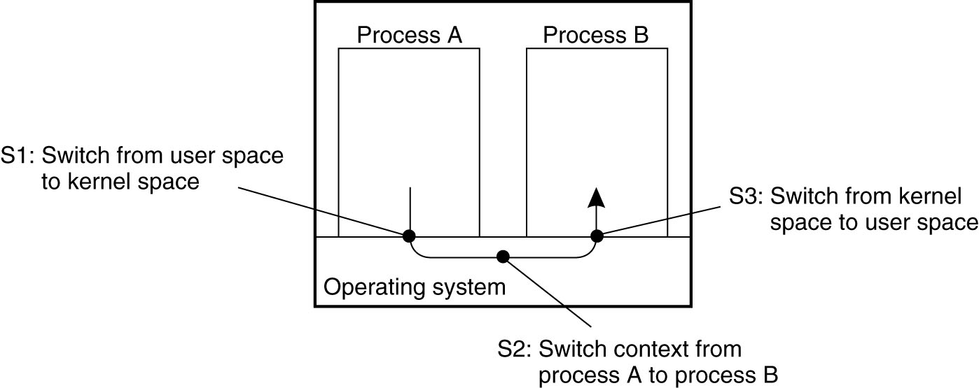
Processes vs Threads
Figure 3-1. Context switching as the result of interprocess communication

Slide 12
Processes vs Threads
Why use threads?
Avoid needless blocking:
a single-threaded process will block when doing I/O; in a multi-threaded process, the operating system can switch the CPU to another thread in that process.
Exploit parallelism:
the threads in a multi-threaded process can be scheduled to run in parallel on a multiprocessor or multicore processor.
Avoid process switching:
structure large applications not as a collection of processes, but through multiple threads.

Slide 13
Processes vs Threads
A thread could be defined as the unit of execution within a process.
Threads could be seen as
lightweight processes as
they have their own stack but
can access shared data.
Which ones are
more vulnerable to
Problems ?
What multithreaded
process does share?

Slide 14
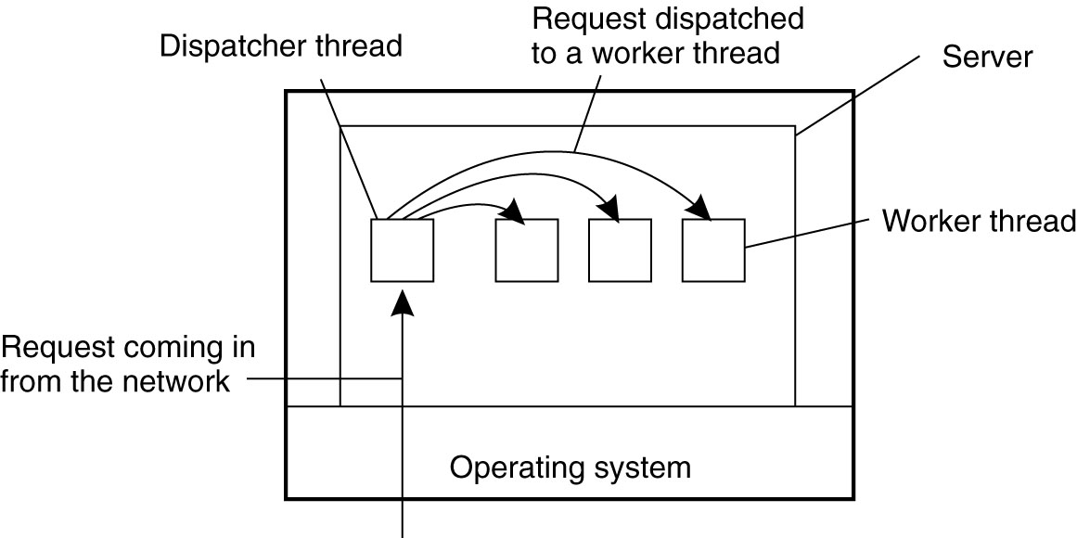
Processes vs Threads
Figure 3-3. A multithreaded server organized in a dispatcher/worker model.

Slide 15
Processes vs Threads
Design Choose: Process over Thread or Thread over Process?
Use-cases:
The Chrome browser
Spreadsheeted
A web client
Which ones are
more vulnerable to
Problems ?
What multithreaded
process does share?

Slide 16
Processes vs Threads
Design Choose: Process over Thread or Thread over Process?
Use-cases:
The Chrome browser (multiple processes)
Spreadsheeted (multiple threads)
A web client (multiple threads)
Which ones are
more vulnerable to
Problems ?
What multithreaded
process does share?

Slide 17
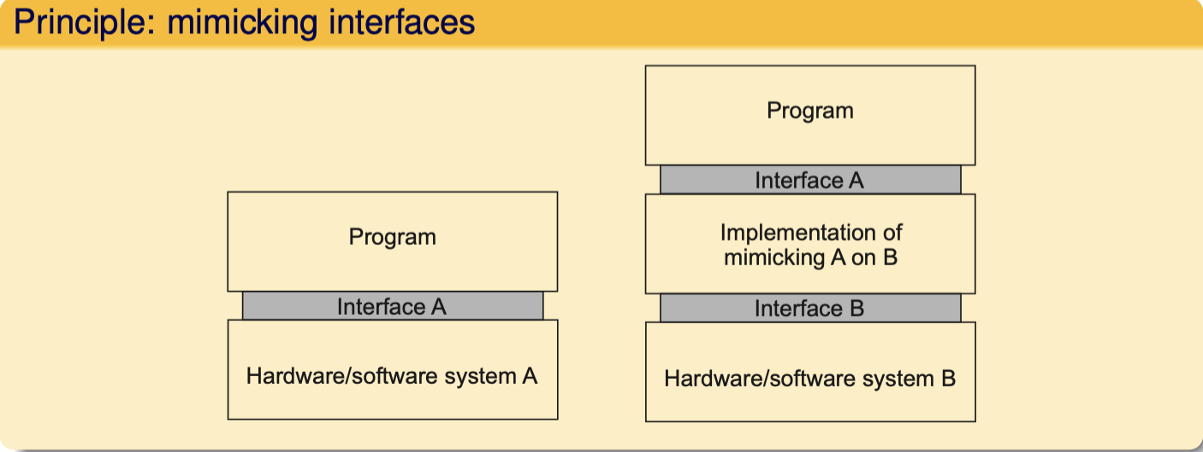
Virtualization
Why do we
need it?
Which ones are
more vulnerable to
Problems ?
What multithreaded
process does share?
(a)
(b)
General organization between a program, interface, and system.
General organization of virtualizing system A on top of system B.

Slide 18
Virtualization
Virtualization is important:
Hardware changes faster than software
Ease of portability and code migration,
Isolation of failing or attacked components
Which ones are
more vulnerable to
Problems ?
What multithreaded
process does share?
(a)
(b)
General organization between a program, interface, and system.
General organization of virtualizing system A on top of system B.

Slide 19
Virtualization
Mimicking interfaces
Four types of interfaces at three different levels
Instruction set architecture: the set of machine instructions, with two subsets:
Privileged instructions: allowed to be executed only by the operating system.
General instructions: can be executed by any program.
System calls as offered by an operating system.
Library calls, known as an application programming interface (API)
Which ones are
more vulnerable to
Problems ?
What multithreaded
process does share?

Slide 20
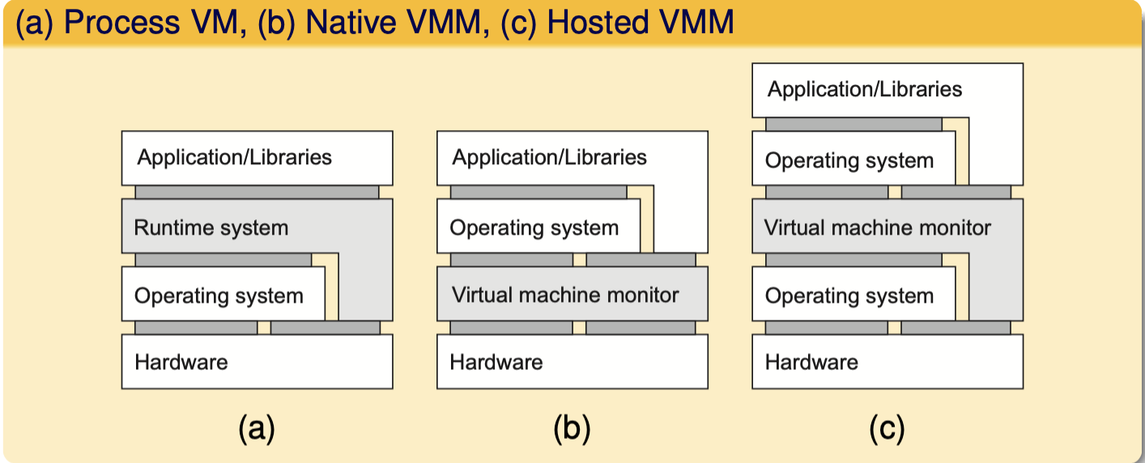
Ways of virtualization
hypervisor
hypervisor
Which ones are
more vulnerable to
Problems ?
What multithreaded
process does share?
(a) Separate set of instructions, an interpreter/emulator, running atop an OS.
(b) Low-level instructions, along with bare-bones minimal operating system
(c) Low-level instructions, but delegating most work to a full-fledged OS.
Notes:
(a) Java runtime environment

Slide 21
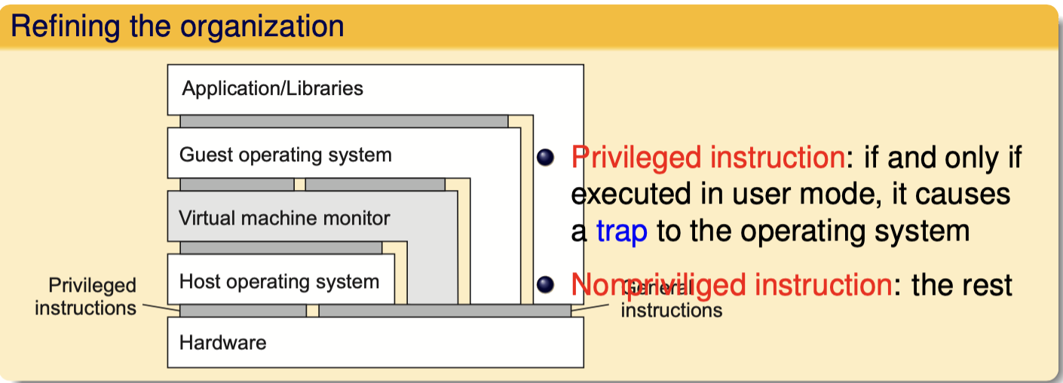
Zooming into VMs: performance
hypervisor
Which ones are
more vulnerable to
Problems ?
What multithreaded
process does share?
Control-sensitive instruction: may affect configuration of a machine (e.g., one affecting relocation register or interrupt table).
Behavior-sensitive instruction: effect is partially determined by context (e.g., POPF sets an interrupt-enabled flag, but only in system mode).
Notes:
(a) Java runtime environment

Slide 22
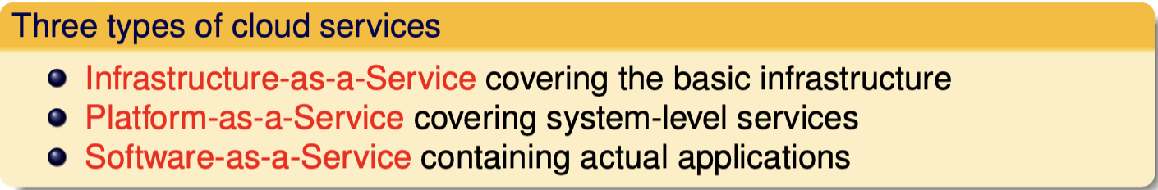
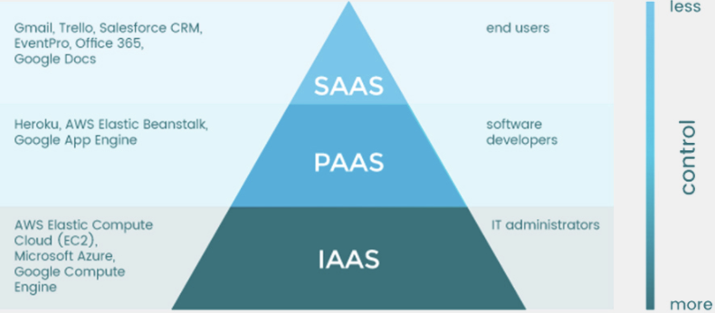
VMs and cloud computing
Which ones are
more vulnerable to
Problems ?
What multithreaded
process does share?
Notes:
(a) Java runtime environment

Slide 23
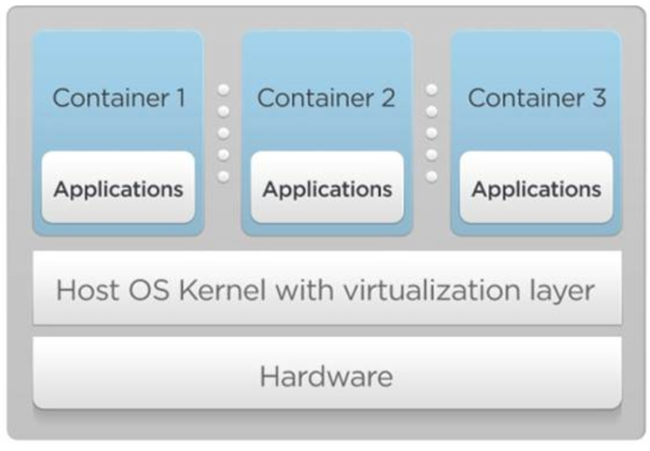
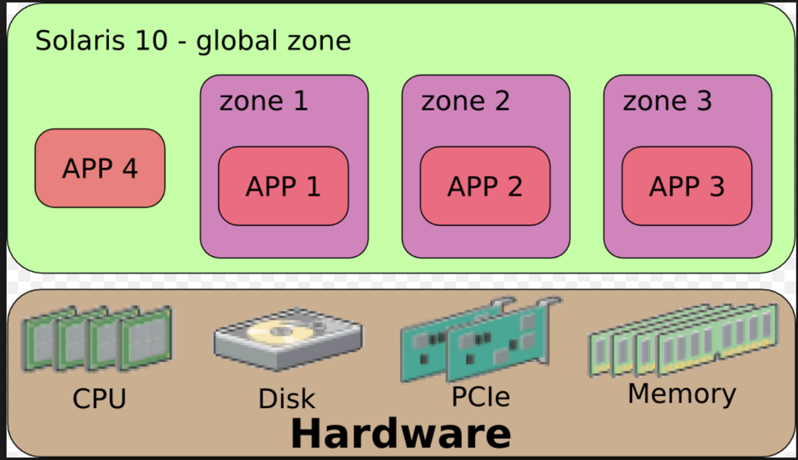
containers
Emulate OS-level interface with native interface
“Lightweight” virtual machines
No hypervisor, OS provides necessary support
Referred to as containers
Solaris containers, BSD jails, Linux containers
23

Slide 24
Docker and Linux Containers
Linux containers are a set of kernel features
Need user space tools to manage containers
Virtuozo, OpenVZm, VServer,Lxc-tools, Docker
What does Docker add to Linux containers?
Portable container deployment across machines
Application-centric: geared for app deployment
Automatic builds: create containers from build files
Component re-use
Docker containers are self-contained: no dependencies
Which ones are
more vulnerable to
Problems ?
What multithreaded
process does share?
Notes:
(a) Java runtime environment

Slide 25
VMs vs Containers
Which ones are
more vulnerable to
Problems ?
What multithreaded
process does share?
Containers share OS kernel of the host
OS provides resource isolation
Benefits
Fast provisioning, bare-metal like performance, lightweight
Notes:
(a) Java runtime environment

Slide 26
VMs vs Containers
VMs | Containers
Heavyweight | Lightweight
Limited performance | Native performance
Each VM runs in its own OS | All containers share the host OS
Hardware-level virtualization | OS virtualization
Startup time in minutes | Startup time in milliseconds
Allocates required memory | Requires less memory space
Fully isolated and hence more secure | Process-level isolation, possibly less secure
Which ones are
more vulnerable to
Problems ?
What multithreaded
process does share?
Notes:
(a) Java runtime environment

Slide 27
A To-Do List
Read Chapters 3, Sec 1, 2 and part of 3
Start building your team

